Slide 1
Data Organization and Retrieval (Basic Linear Data Structures) [ Review ]
Subhasis Bhattacharjee
Computer Science & Engineering, IIT Jammu

Slide 2
Outline
Lists
Stack
Queue
Deque

Slide 3
List
List (or List ADT) is explicit linear ordered data
The most obvious implementation is to use either an array or linked list
finding, inserting new entries before or after, or erasing entries at
the first location (the front) – runtime Θ(1)
an arbitrary (k^{th}) location – runtime O(n)
the last location (the back or n^{th}) – runtime Θ(n)
Concatenating two linked lists can be done in Θ(n)
With tail pointer – runtime Θ(1)
Allocation and deallocating the memory requires Θ(n) time

Slide 4
Types / Number / Direction of Link in List
Singly linked list
Doubly linked list

Slide 5
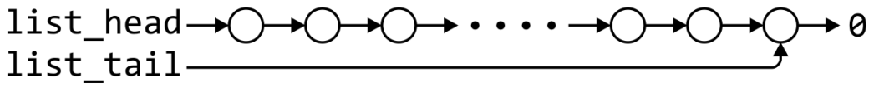
Singly Linked List
 | Front/1st node | k^{th} node | Back/n^{th} node
Find | Θ(1) | Ο(n)* | Θ(1)
Insert Before | Θ(1) | Ο(n)* | Θ(n)
Insert After | Θ(1) | Θ(1)* | Θ(1)
Replace | Θ(1) | Θ(1)* | Θ(1)
Erase | Θ(1) | Ο(n)* | Θ(n)
Next | Θ(1) | Θ(1)* | n/a
Previous | n/a | Ο(n)* | Θ(n)
* These assume we have already accessed the k^{th} entry—an O(n) operation

Slide 6
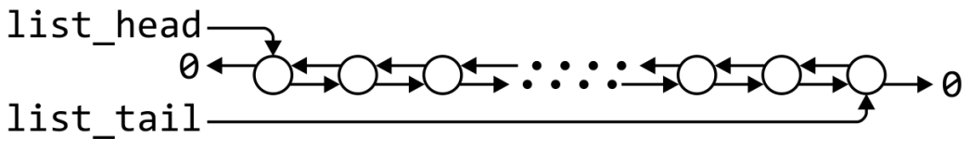
Doubly Linked List
 | Front/1st node | k^{th} node | Back/n^{th} node
Find | Θ(1) | Ο(n)* | Θ(1)
Insert Before | Θ(1) | Θ(1)* | Θ(1)
Insert After | Θ(1) | Θ(1)* | Θ(1)
Replace | Θ(1) | Θ(1)* | Θ(1)
Erase | Θ(1) | Θ(1)* | Θ(1)
Next | Θ(1) | Θ(1)* | n/a
Previous | n/a | Θ(1)* | Θ(1)
* These assume we have already accessed the k^{th} entry—an O(n) operation

Slide 7
Doubly Linked List – contd.
Accessing the k^{th} entry is O(n)
 | k^{th} node
Insert Before | Θ(1)
Insert After | Θ(1)
Replace | Θ(1)
Erase | Θ(1)
Next | Θ(1)
Previous | Θ(1)

Slide 8
Stack
Stack provides operations:
Uses a explicit linear ordering
Insertions and removals are performed individually
Inserted objects are pushed onto the stack
The top of the stack is the most recently object pushed onto the stack
When an object is popped from the stack, the current top is erased

Slide 9
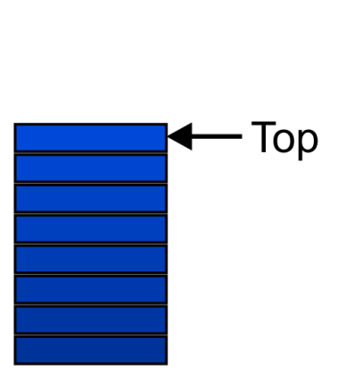
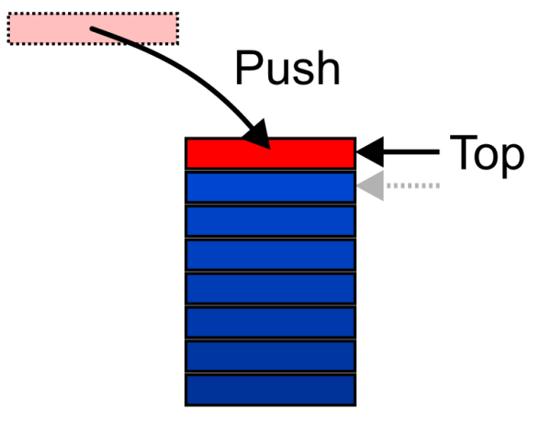
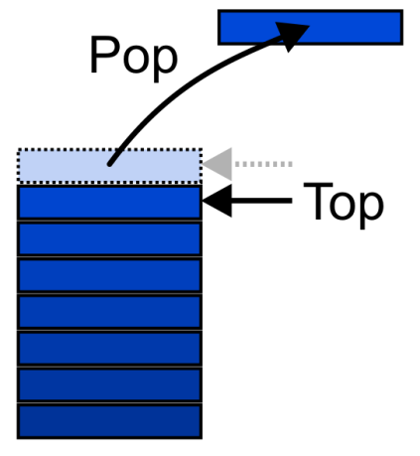
Stack / last-in–first-out (LIFO)
Implementation can be using:
Singly linked lists
One-ended arrays

Slide 10

Stack Implementation by Linked-List
Operations at the front of a singly linked list are all Θ(1)
The desired behaviour of Stack by performing all operations at the front / top
 | Front/1st | Back/n^{th}
Find | Θ(1) | Θ(1)
Insert | Θ(1) | Θ(1)
Erase | Θ(1) | Θ(n)

Slide 11

Stack Implementation by Array
For one-ended arrays, all operations at the back are Θ(1)
 | Front/1st | Back/n^{th}
Find | Θ(1) | Θ(1)
Insert | Θ(n) | Θ(1)
Erase | Θ(n) | Θ(1)

Slide 12
Queue
Uses a explicit linear ordering
There are no restrictions on objects inserted into (pushed onto) the queue - that object is designated the back of the queue
The object designated as the front of the queue is the object which was in the queue the longest
The remove operation (popping from the queue) removes the current front of the queue
first-in–first-out (FIFO) data structure

Slide 13
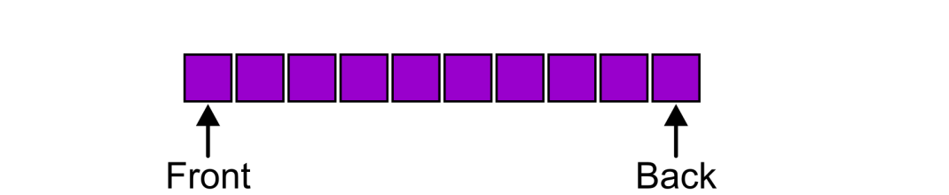
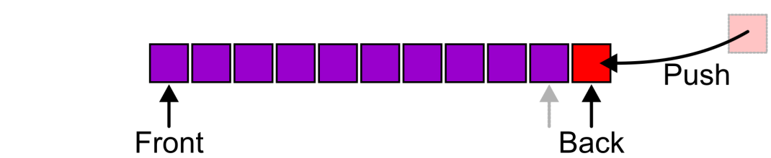
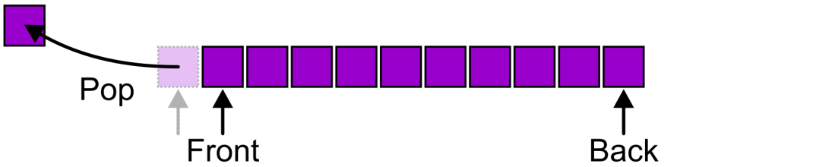
Queue Pictorially

Slide 14
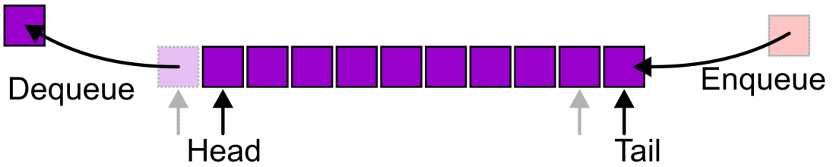
Queue Pictorially – contd.

Slide 15
Queue - Implementation
Two implementations
Singly linked lists
Circular arrays
Requirements:
All queue operations must run in Θ(1) time

Slide 16
Queue Implemented by Linked-List
Removal is only possible at the front with Θ(1) run time
 | Front/1st | Back/n^{th}
Find | Θ(1) | Θ(1)
Insert | Θ(1) | Θ(1)
Erase | Θ(1) | Θ(n)

Slide 17
Queue Implemented by Array
A one-ended array does not allow all operations to occur in Θ(1) time
 | Front/1st | Back/n^{th}
Find | Θ(1) | Θ(1)
Insert | Θ(n) | Θ(1)
Erase | Θ(n) | Θ(1)

Slide 18
Queue Implemented by two-ended Array
Using a two-ended array, Θ(1) are possible by pushing at the back and popping from the front
 | Front/1st | Back/n^{th}
Find | Θ(1) | Θ(1)
Insert | Θ(1) | Θ(1)
Remove | Θ(1) | Θ(1)

Slide 19
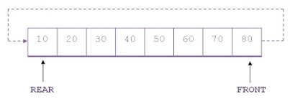
Queue Implemented by [ Circular ] Array
Considering the array as circular i.e. a[i] = a[i % n]

Slide 20
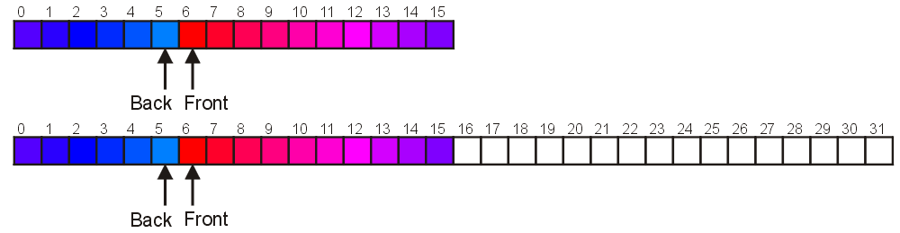
Capacity Enhancement in Q [Circular Array]
A direct copy does not work

Slide 21
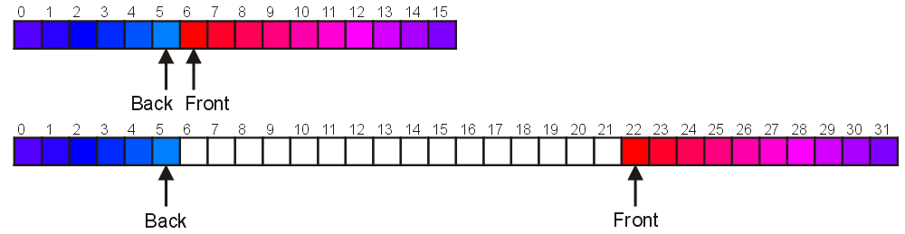
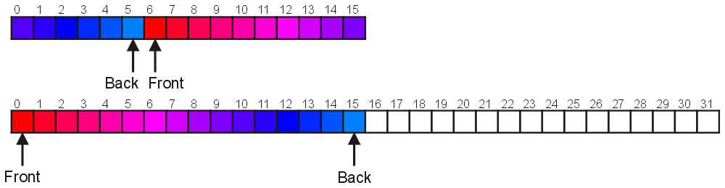
Capacity Enhancement in Q – Two Solutions
Move those beyond the front to the end of the array
Map the front back at position 0

Slide 22
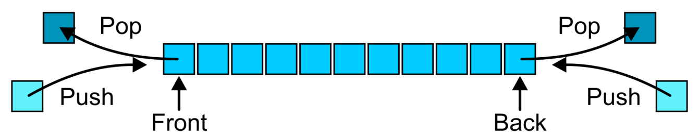
Deques
Abstract Deque operations:
Uses a explicit linear ordering
Insertions and removals are performed individually
Allows insertions at both the front and back of the deque
Can be implemented using a doubly linked list or a circular array

Slide 23
Deque Operations
The operations will be called
front back
push_front push_back
pop_front pop_back

